Slide 1


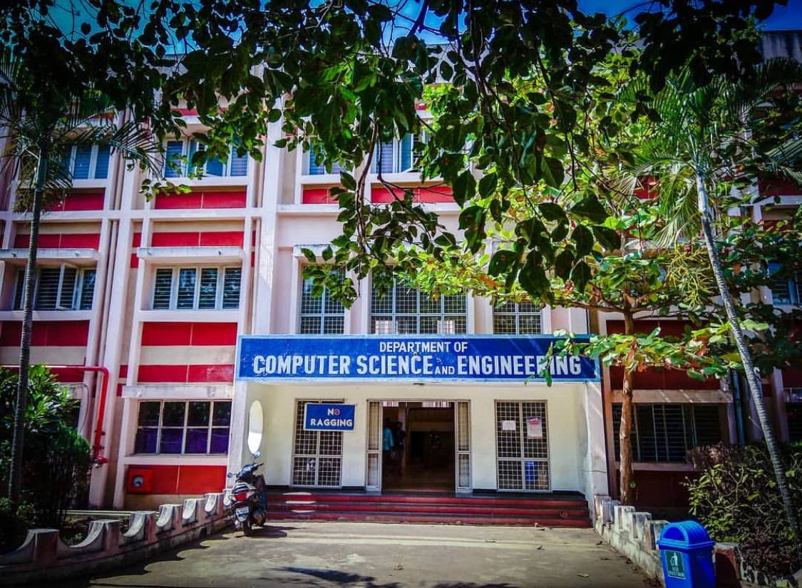
ANALYZING TRENDS OF INSTAGRAM
Batch
12C
P. Aditya Goutam
21331A05E1
V.V.S. Chandra Mouli
21331A05I0
T. Damayanthi
21331A05H6
S. Vamshi Krishna
22335A0516
Project Supervisor
Mrs. K. Sobha Rani
Professor(TP)
Project In charge
Dr. P. Rama Santosh Naidu
Senior Assistant Professor
Head of the Department
Dr. T. Pavan Kumar
Professor

Slide 2
1 | Abstract
2 | Introduction
3 | Related Work
4 | Proposed Work
5 | Project Timeline
6 | Implementation & Methodology
7 | Results
8 | Conclusion & Future Work
9 | References
AGENDA

Slide 3

Abstract
This project aims to gather, process, and analyze a comprehensive dataset combining Instagram user activity, trend analysis, and financial information. By integrating various data sources, we seek to uncover insights into user behavior, popular trends, and the economic impact of Instagram's influence. Data visualization techniques will create intuitive and informative representations of the findings. Statistical methods and machine learning algorithms will be employed to predict future trends and behaviors. The project will provide a detailed understanding of how Instagram trends evolve and how they correlate with financial metrics. The goal is to offer actionable insights for marketers, businesses, and content creators to optimize their strategies on the platform, highlighting the significance of data-driven decision-making in the digital age.

Slide 4
Introduction
Social media analytics has become essential for businesses and researchers to understand the vast data generated by platforms like Facebook, Twitter, and Instagram. By examining user interactions, content popularity, and engagement metrics, these analytics offer deep insights into consumer behavior and market trends. The rapid growth of social networks has transformed information dissemination, creating a global web of influence. With billions of users, social media platforms provide unparalleled opportunities for data-driven decision-making, fostering connections and shaping public discourse.
Instagram, as an example, illustrates these broader social media dynamics through its trends and user activities. By analyzing Instagram data, one can uncover insights into user behavior, popular trends, and their financial implications. Predictive analytics and machine learning techniques help identify trends and forecast future behaviors. This project aims to provide actionable insights for marketers, businesses, and content creators, enhancing their understanding of social media trends and their impact on various industries.

Slide 5
Related Work
Content-based filtering is a recommendation technique that suggests items based on user preferences and item features.
It analyzes attributes like genre, keywords, or descriptions to recommend similar items.
Machine learning models or similarity measures (e.g., cosine similarity) are commonly used.
It does not require data from other users, making it useful for personalized recommendations.
A major limitation is the "cold start" problem for new users with no prior data.
Two-tower neural networks consist of two separate neural network models processing different input types.
Each tower extracts features independently before combining them in a shared representation space.
They are commonly used in recommendation systems, search ranking, and matching tasks.
One tower processes user data while the other processes item data to compute relevance.
Training involves minimizing the distance between positive pairs and maximizing it for negative pairs.

Slide 6
Proposed Work
Observe recommendation systems made in different fields to get an idea about recommendation systems.
Try to replicate a social network like Instagram using application-specific API.
Analyze user activities and network growth within a social network.
Observe the patterns of vocabulary usage and semantics of natural language.

Slide 7
Project Timeline
Detailed timeline with milestones and deadlines for each phase of the project implementation.
Gantt chart (optional but recommended for visual representation).
 | Jul - Aug | Aug - Oct | Oct -Nov | Nov - Dec | Dec - Jan | Jan - Feb | Feb - Mar
Domain Analysis & Problem Definition | Completed | Completed | Completed | Completed | Completed | Completed | Completed
Literature Survey | Started | Completed | Completed | Completed | Completed | Completed | Completed
Design | - | Stated | Completed | Completed | Completed | Completed | Completed
Coding & Deployment | - | Completed | Completed | Completed | Completed | Completed | Completed
Implementation & Methodology | - | - | Completed | Completed | Completed | Completed | Completed

Slide 8
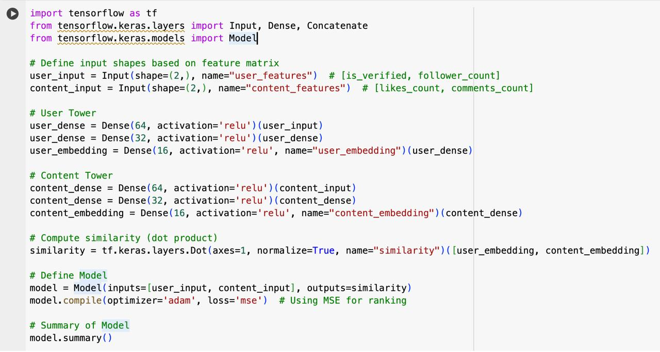
Implementation & Methodology
Project Link: Click here

Slide 9
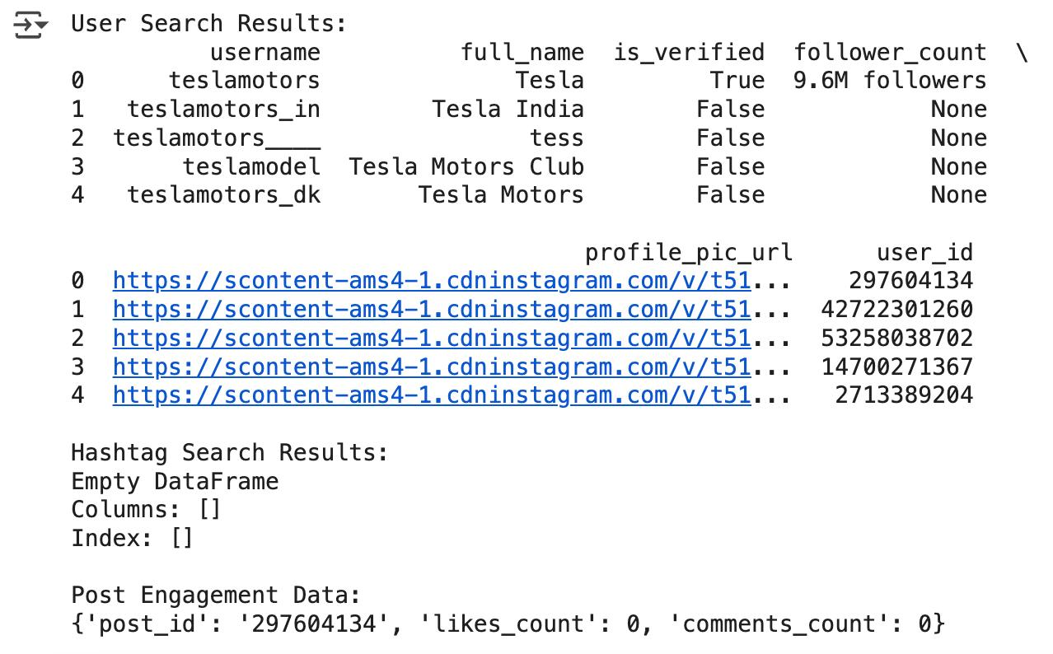
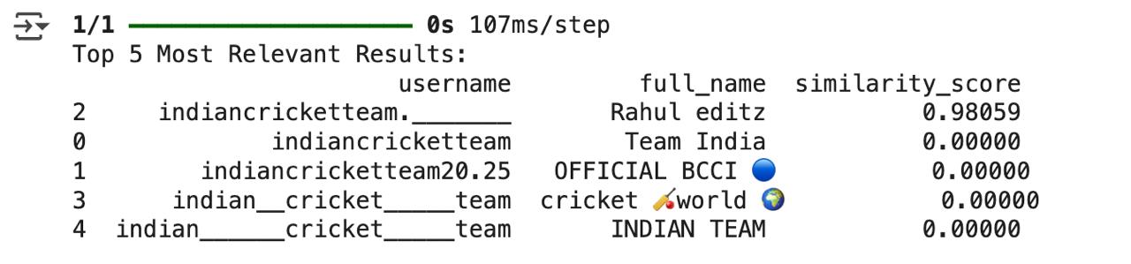

Results

Slide 10
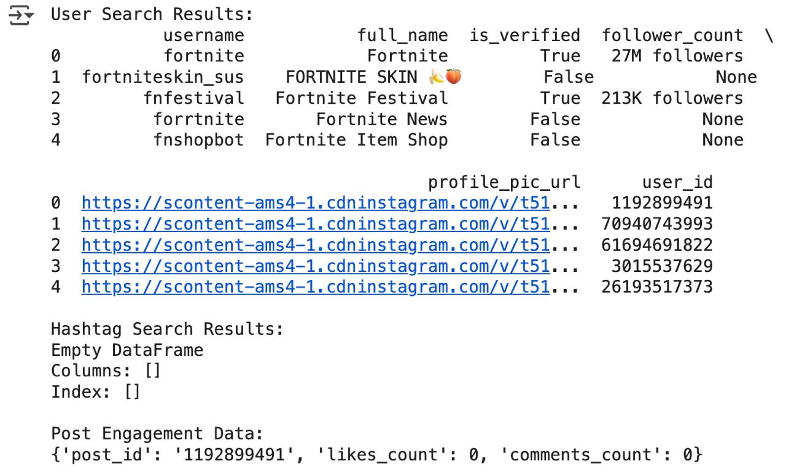
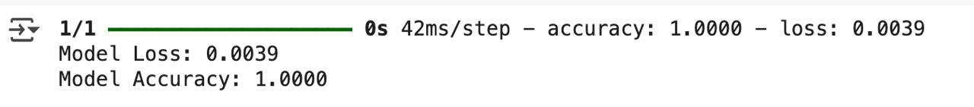
Results(Cont.)

Slide 11

Conclusion & Future Work
In the conclusion, we proved that this approach is much more effective and it is able to overcome the limitation imposed by the Social Media algorithms. Moreover, this work could be considered an advice to big Social Media, as Instagram, on how user can behave to reach their goals, eventually taking some countermeasures.
The preliminary results achieved so far are encouraging further research and development activities towards the inclusion of additional features in the project implementation.
Then those strategies could be enhanced using some Machine Learning techniques. This last approach could be interesting to better address the Bot operations and to avoid some undesired behavior (i.e avoid to leave likes or comments on discriminatory posts).

Slide 12
References
Cross-platform recommendation system from Facebook to Instagram: Click Here
Filtering Instagram Hashtags Through Crowd tagging: Click Here
Tourism Recommender System using Machine Learning Based on User's Public Instagram Photos: Click Here
Movie Account Recommendation on Instagram: Click Here
Two tower neural network is an actual network model that is used inside instagram in real time:Click Here
How instagram works the ranking:Click Here

Slide 13
Abstract | Introduction
Related Work | Proposed Work
Implementation & Methodlogy | Results
Conclusion & Future Work | Any Queries?
SUMMARY
12

Slide 14
P. Aditya Goutam
V.V.S. Chandra Mouli
Our Team
T. Damayanthi
S. Vamshi Krishna

Slide 15
Acknowledgements
We would like to express my sincere gratitude to Mrs. K. Sobha Rani for their invaluable guidance and support throughout this project. we also thankful for providing access to resources and tools necessary for this research. Special thanks to my peers, [Names], for their insightful discussions and assistance with data collection.

Slide 16
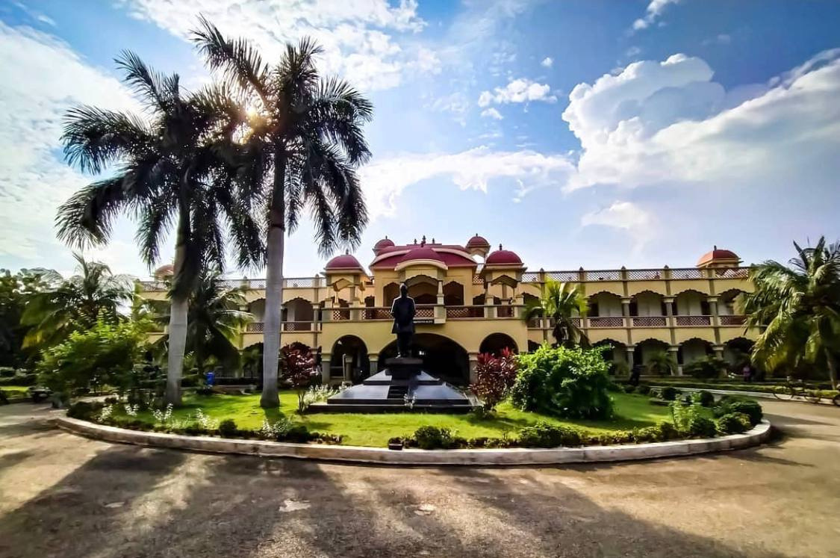

Thank You!

